Slide 1
Character Mood Board

Slide 2
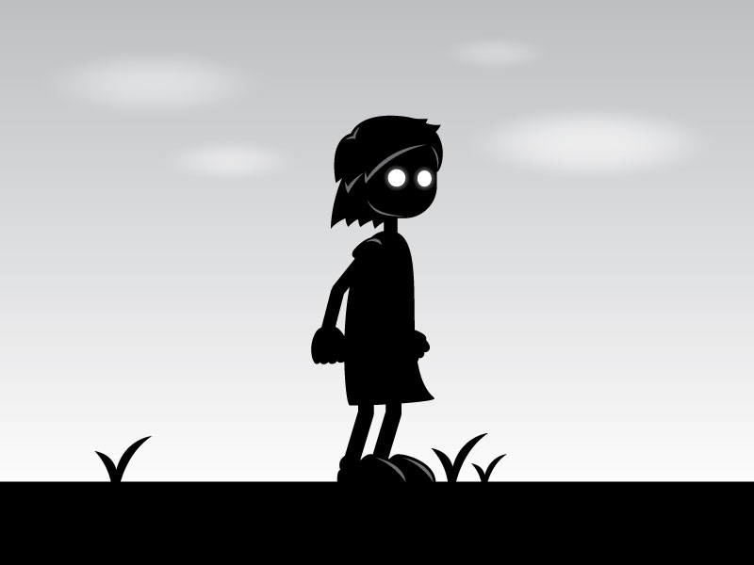
With this character I’m drawn to his big white eyes. This character plain eyes shows me that their physical body is present but there mind is somewhere else.

Slide 3
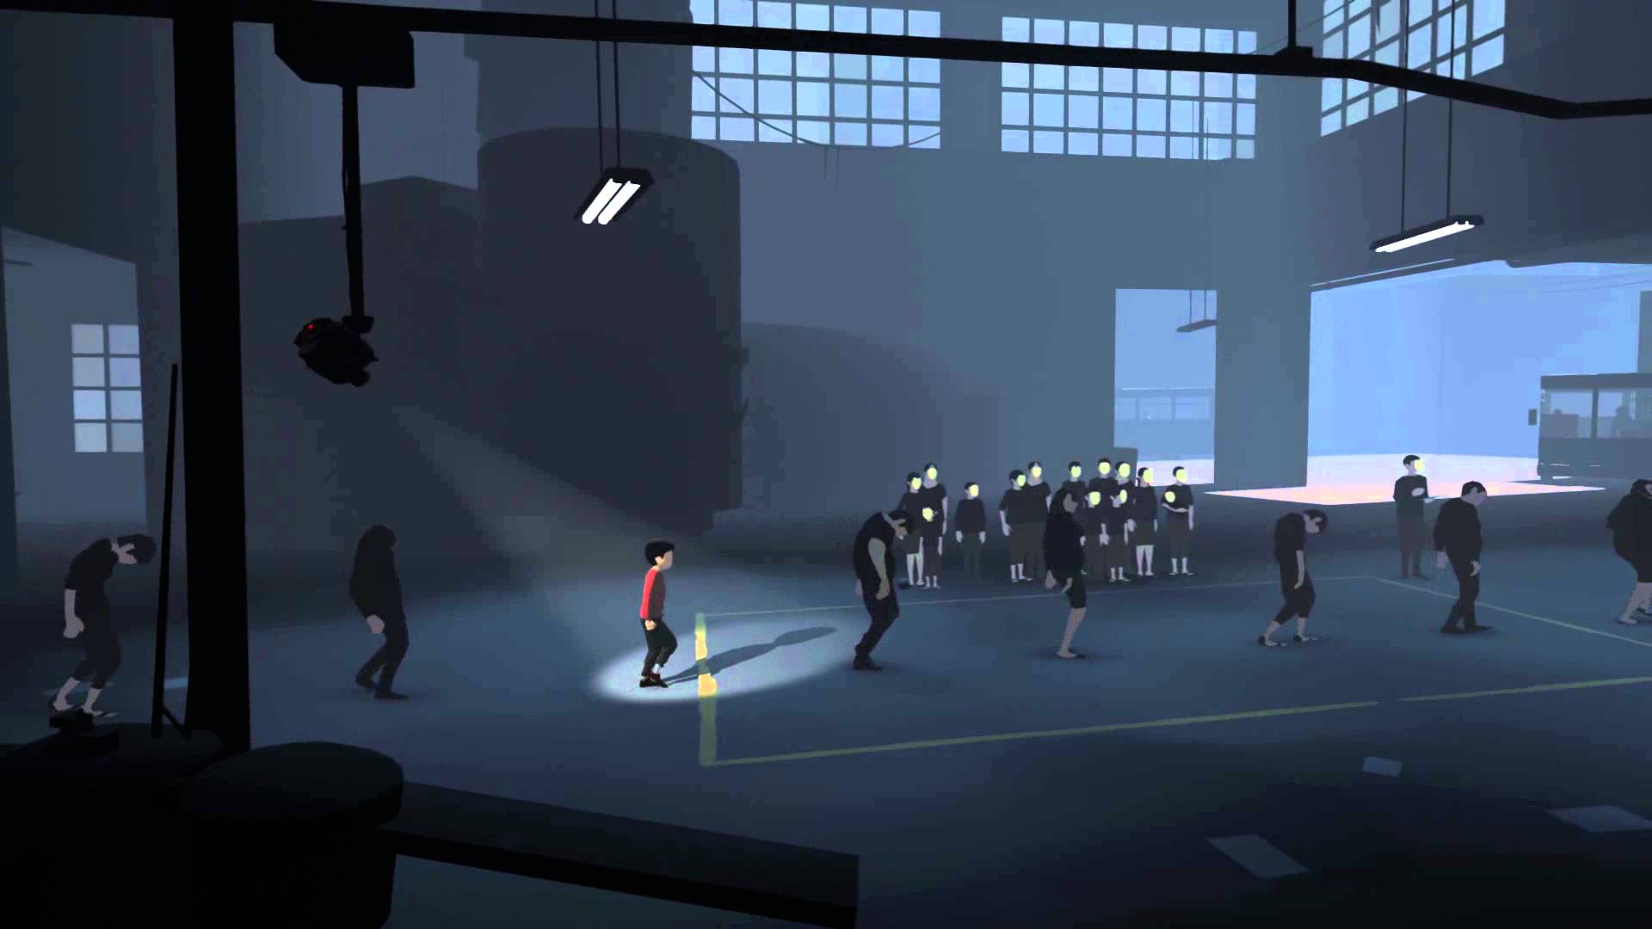
With this character I really like the clothing choice. The world around is dull and lifeless and the main protagonist is wearing a red shirt and seems to have more colour on them. This idea is useful with trying to show being out of place.

Slide 4
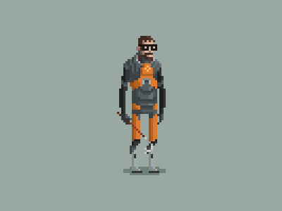
With this character the blank facial expression is a good indication that is character could be that he is numb from any emotion, his body language also suggest that he is not entirely sure what is going on. This would work well with our character by giving him negative facial and body language to represent his confusion of why the trip is suddenly disappearing from memory

Slide 5
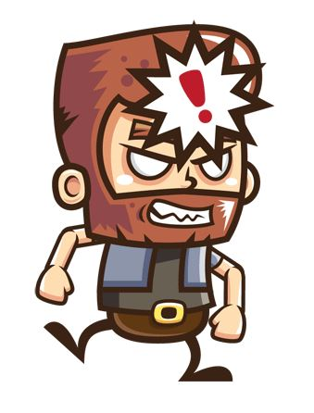
I really enjoy the look of this character, the consent smoothness around the whole character. The visible shadows on the clothes. I also like the amount of detail gone into the head but others parts e.g. his body have less detail. This really makes you look closer at his face and see if there are any visible fascial expressions.

